Slide 1
Natural Language Processing

Slide 2
Natural language processing (NLP) is a field of computer science and linguistics concerned with the interactions between computers and human (natural) languages. In theory, natural-language processing is a very attractive method of human-computer interaction. Natural language understanding is sometimes referred to as an AI-complete problem, because natural-language recognition seems to require extensive knowledge about the outside world and the ability to manipulate it.
NLP has significant overlap with the field of computational linguistics, and is often considered a sub-field of artificial intelligence.

Slide 3
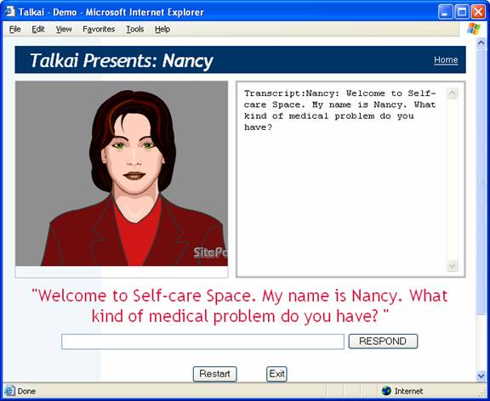

Slide 4
HISTORY
Research in natural language processing has been going on for several decades dating back to the late 1940s.
Machine translation (MT) was the first computer-based application related to natural language.
While Weaver and Booth started one of the earliest MT projects in 1946 on computer translation based on expertise in breaking enemy codes during World War II.
In 1957 Chomsky published Syntactic Structures introducing the idea of generative grammar.
During this period, other NLP application areas began to emerge, such as speech recognition.
By the end of 1980s, symbolic approaches had been used to address many significant problems in NLP and statistical approaches were shown to be complementary in many respects to symbolic approaches.

Slide 5
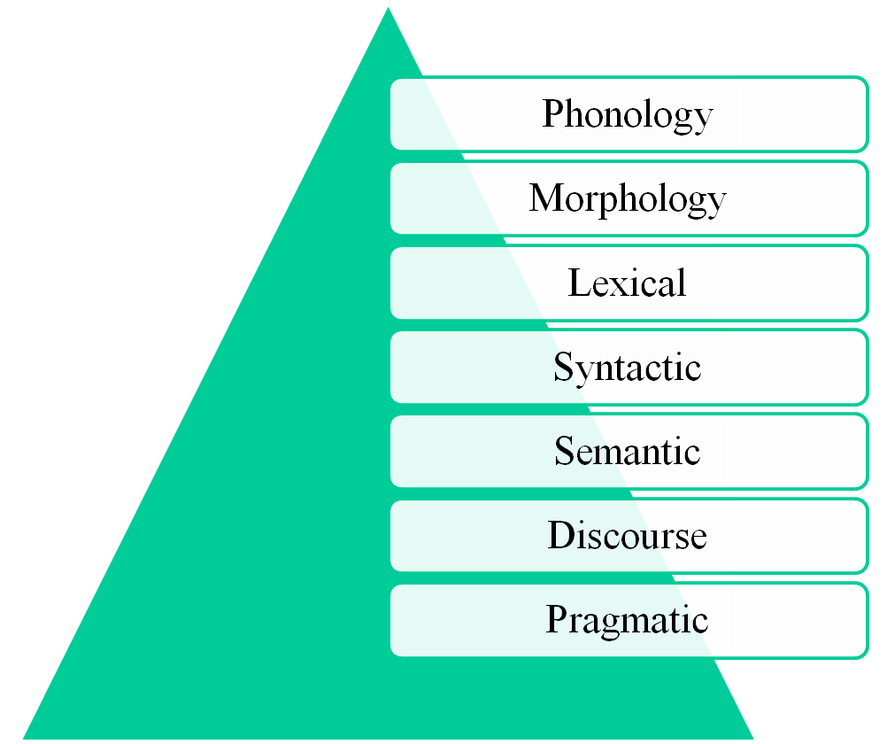
LEVELS OF NATURAL LANGUAGE PROCESSING

Slide 6
Phonology-This level deals with the interpretation of speech sounds within and across words. There are, in fact, three types of rules used in phonological analysis: 1) phonetic rules 2) phonemic rules 3) prosodic rules.
Morphology-This level deals with the componential nature of words, which are composed of morphemes – the smallest units of meaning.
Lexical-At this level, humans, as well as NLP systems, interpret the meaning of individual words.
Syntactic-This level focuses on analyzing the words in a sentence so as to uncover the grammatical structure of the sentence.
Semantic-This is the level at which most people think meaning is determined, however, as we can see in the above defining of the levels, it is all the levels that contribute to meaning.
Discourse-While syntax and semantics work with sentence-length units, the discourse level of NLP works with units of text longer than a sentence.
Pragmatic-This level is concerned with the purposeful use of language in situations and utilizes context over and above the contents of the text for understanding.

Slide 7
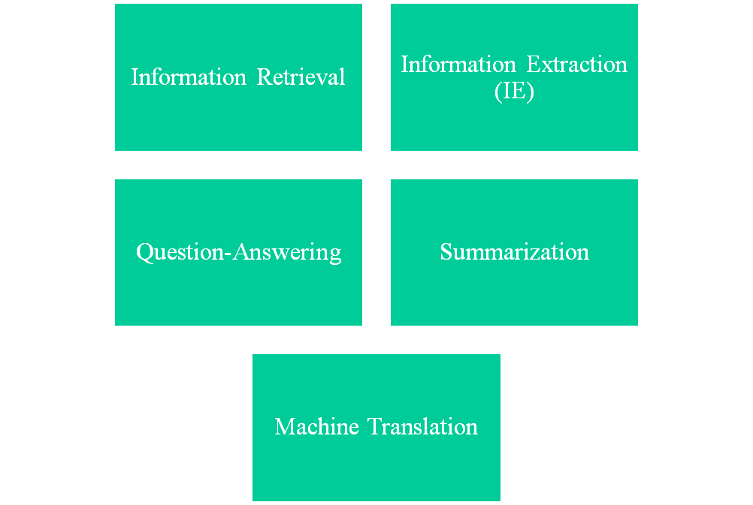
NATURAL LANGUAGE PROCESSING APPLICATIONS

Slide 8
Information Retrieval – given the significant presence of text in this application, it is surprising that so few implementations utilize NLP. Recently, statistical approaches for accomplishing NLP have seen more utilization, but few systems other than those by Liddy (37) and Strzalkowski (38) have developed significant systems based on NLP.
Information Extraction (IE) – a more recent application area, IE focuses on the recognition, tagging, and extraction into a structured representation, certain key elements of information, e.g. persons, companies, locations, organizations, from large collections of text. These extractions can then be utilized for a range of applications including question-answering, visualization, and data mining.
Question-Answering – in contrast to Information Retrieval, which provides a list of potentially relevant documents in response to a user’s query, question-answering provides the user with either just the text of the answer itself or answer-providing passages.

Slide 9
Summarization – the higher levels of NLP, particularly the discourse level, can empower an implementation that reduces a larger text into a shorter, yet richly constituted abbreviated narrative representation of the original document.
Machine Translation – perhaps the oldest of all NLP applications, various levels of NLP have been utilized in MT systems, ranging from the ‘word-based’ approach to applications that include higher levels of analysis.

Slide 10


Any Light at The End of The Tunnel?
Yahoo, Google, Microsoft → Information Retrieval
Monster.com, HotJobs.com (Job finders) → Information Extraction + Information Retrieval
Systran powers Babelfish → Machine Translation
Ask Jeeves → Question Answering
Myspace, Facebook, Blogspot → Processing of User-Generated Content
Tools for “business intelligence”
All “Big Guys” have (several) strong NLP research labs:
  IBM, Microsoft, AT&T, Xerox, Sun, etc.
Academia: research in an university environment

Slide 11
Why Natural Language Processing ?
Huge amounts of data
  Internet = at least 20 billions pages
  Intranet
Applications for processing large amounts of texts
require NLP expertise
Classify text into categories
Index and search large texts
Automatic translation
Speech understanding
  Understand phone conversations
Information extraction
  Extract useful information from resumes
Automatic summarization
  Condense 1 book into 1 page
Question answering
Knowledge acquisition
Text generations / dialogues

Slide 12
Natural?
Natural Language?
  Refers to the language spoken by people, e.g. English, Japanese, Swahili, as opposed to artificial languages, like C++, Java, etc.
Natural Language Processing
  Applications that deal with natural language in a way or another
[Computational Linguistics
  Doing linguistics on computers
  More on the linguistic side than NLP, but closely related ]

Slide 13
Computers Lack Knowledge!
Computers “see” text in English the same you have seen the previous text!
People have no trouble understanding language
  Common sense knowledge
  Reasoning capacity
  Experience
Computers have
  No common sense knowledge
  No reasoning capacity

Slide 14
Where does it fit in the CS taxonomy?
Computers
Databases
Artificial Intelligence
Algorithms
Networking
Robotics
Natural Language Processing
Search
Information
Retrieval
Machine
Translation
Language
Analysis
Semantics
Parsing

Slide 15
Linguistics Levels of Analysis
Speech
Written language
  Phonology: sounds / letters / pronunciation
  Morphology: the structure of words
  Syntax: how these sequences are structured
  Semantics: meaning of the strings
Interaction between levels

Slide 16

THANK YOU

